Slide 1
Automation Framework
Generic test automation framework for acceptance testing and acceptance test-driven development (ATDD).
It has easy-to-use tabular test data syntax and it utilizes the keyword-driven testing approach.
Its testing capabilities can be extended by test libraries implemented either with Python or Java, and users can create new higher-level keywords from existing ones using the same syntax that is used for creating test cases.
The core framework is implemented using Python and runs also on Jython (JVM) and Iron Python (.NET).
It is a open source software released under Apache License 2.0
Most of the libraries and tools are also open source.

Slide 2
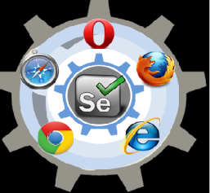
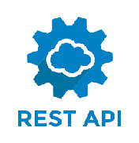
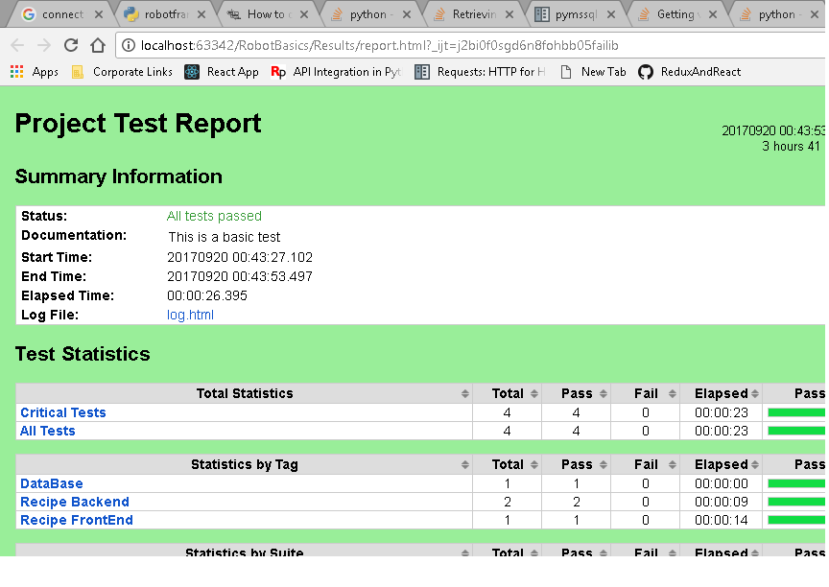

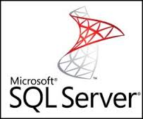
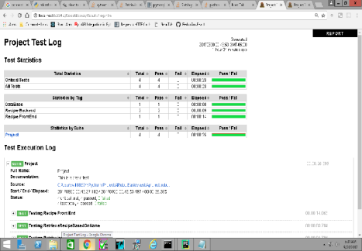
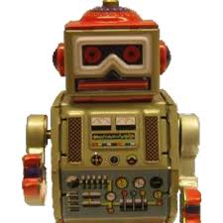
Over All Test Automation Architecture For Recipe Editor
r
Reports
Automation Logs and Reports
ReactJS + Spring Boot + Hibernate
Logs
Automation Framework + Scripts
Python or Java Scripts
Standard Libraries
External Libraries
Custom Libraries

Slide 3
Rest Api Test Framework for Recipe Editor
TEST DATA
Compare the Expected and the Actual between the DB data and Rest data
Reporting
Script
Script
Script
Script
Test Suite reports
JSON
testRetrieve
byName
testSave
byName
testEdit
byName
testDel
byName
Test Script reports
Config
API.py
Sessions.py
GetdataFromDB
Get
Post
PUT
DEL
GetConnections
SSL Verifications
Add Headers
Response
XML
Test Logs
Auth.py
Cookies.py
Exceptions.py
Data
Base
SpringBoot
ApacheTomcat

Slide 4
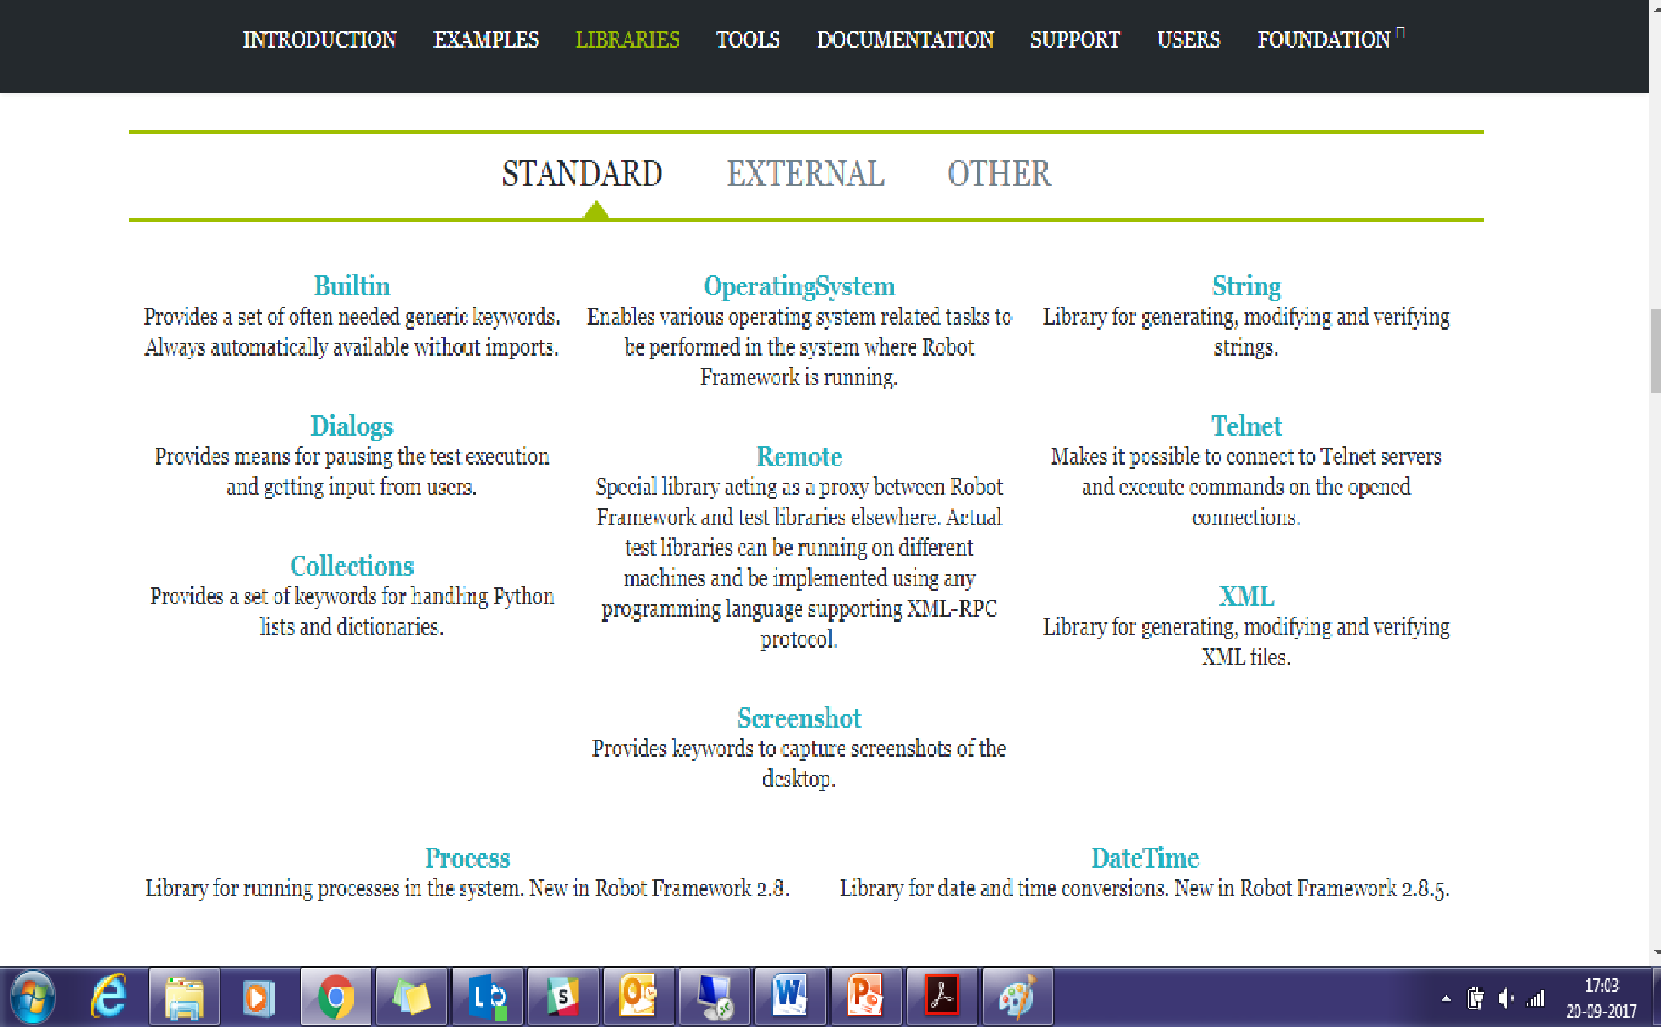

Slide 5
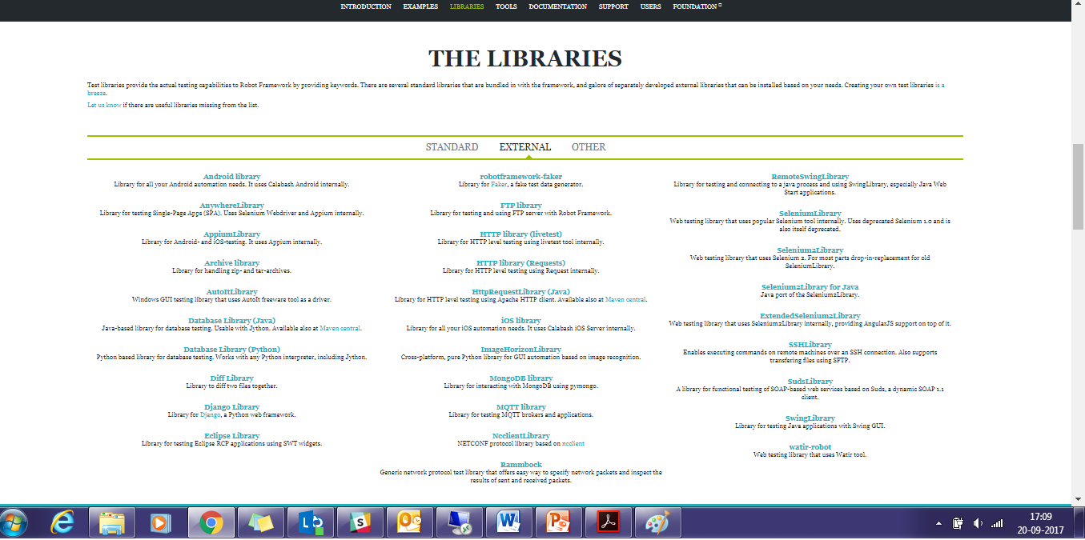

Slide 6
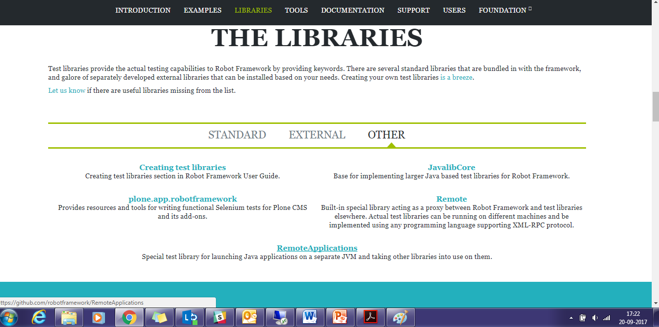

Slide 7
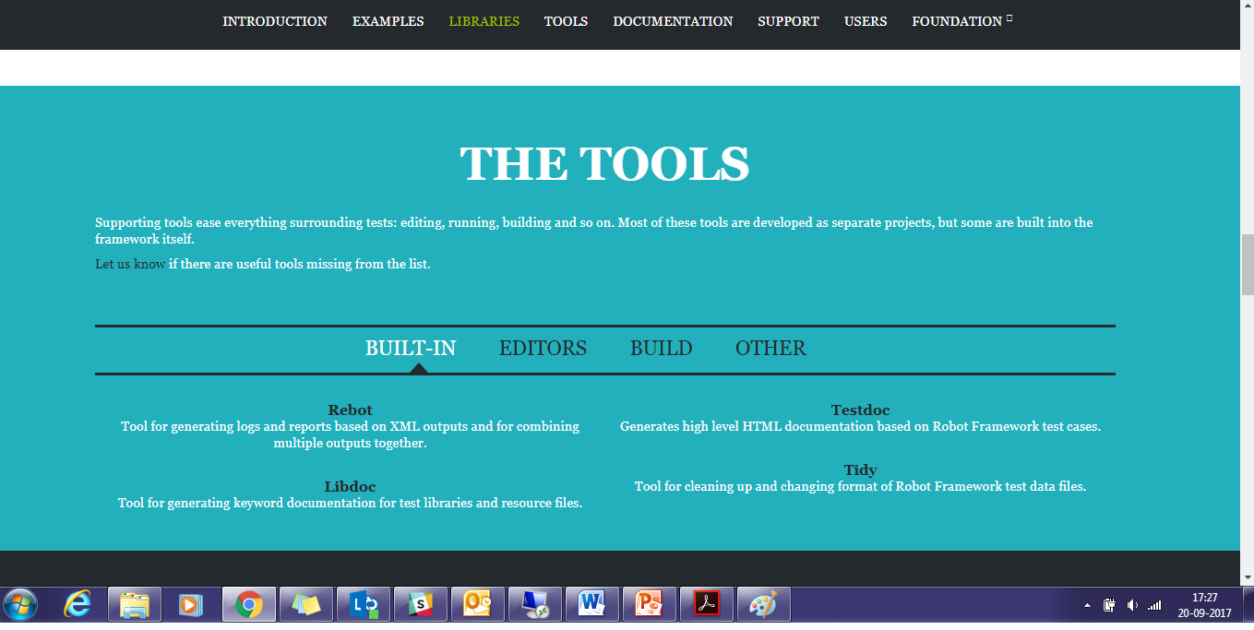

Slide 8
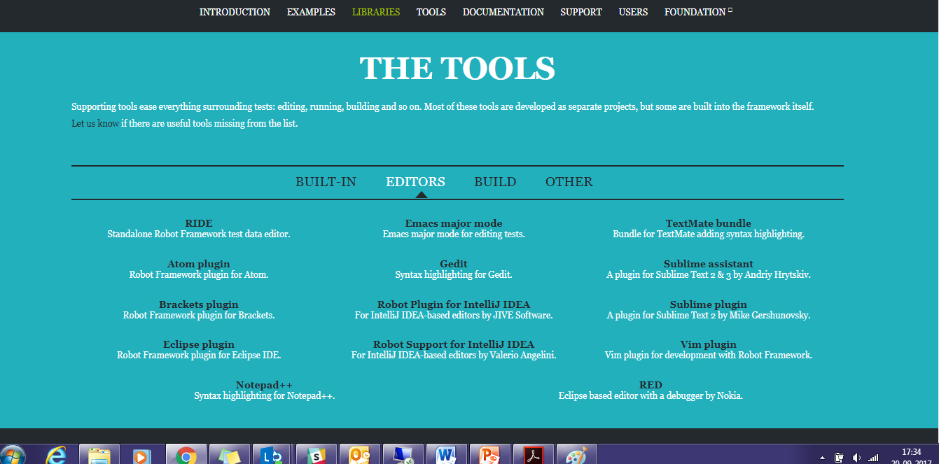

Slide 9
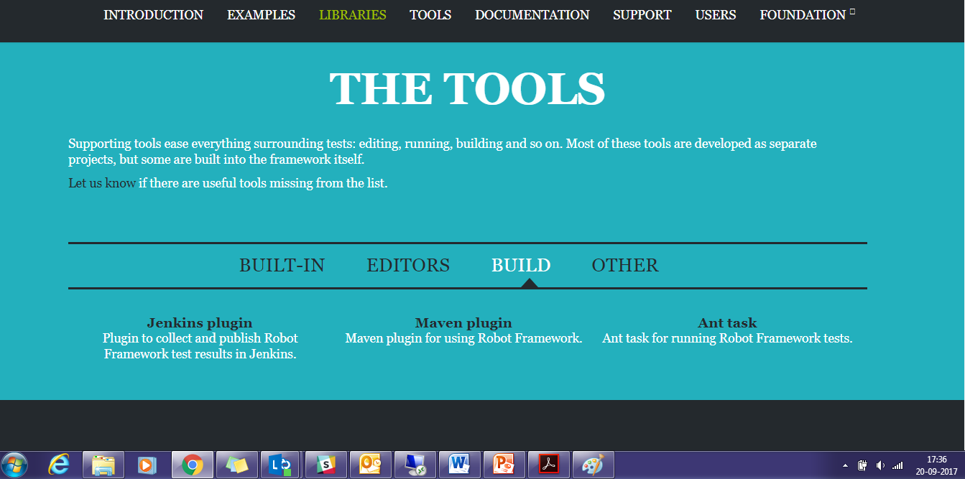

Slide 10
